Slide 1

TO-DO LIST

Slide 2
TEAM MEMBERS
2310030060 - M ADITI
2310030179 - A VEENA
2310030185 - JEEVANA
2310030328 -
V LAVANYA

Slide 3
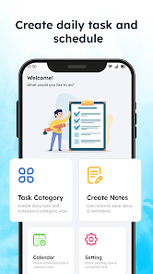
AIM
The aim of this project is to develop a full-stack To-Do List Application that enables users to efficiently manage their tasks by adding, updating, deleting, and organizing them based on priority and deadlines. The application will provide a seamless user experience with an interactive front-end and a robust backend for data storage and retrieval.

Slide 4
OBJECTIVE
User-Friendly Interface: Develop a clean and intuitive UI using HTML, CSS, and JavaScript for easy task management.
Task Management: Allow users to add, edit, delete, and mark tasks as complete to improve productivity.
Database Integration: Implement a MySQL database to store tasks persistently, ensuring data is not lost on refresh.
Task Prioritization & Deadlines: Enable users to set deadlines and priority levels for better organization.
Data Persistence: Use MySQL for secure and efficient task storage and retrieval.
Mobile Responsiveness: Ensure the application is responsive and accessible across different devices.
Error Handling & Security: Implement error handling and security measures to prevent unauthorized access and data loss.

